Slide 1
Self Driving RC car
Autonomous car

Slide 2
Outline
What’s autonomous car ?
Our objective
Our project modules
Neural Network
Object detection
Monocular vision and camera calibration
Results

Slide 3
What’s autonomous car ?
Partially or fully drive themselves and which may ultimately require no driver at all.
To make cars safer, drivers more aware, and accidents less likely.
The technology appears close to maturity and commercial introduction.
Reducing the opportunity for human error

Slide 4
Our objective
Modulate a RC car to handle three tasks:
Self-driving on the track.
Stop sign and traffic light detection.
Front collision avoidance.

Slide 5
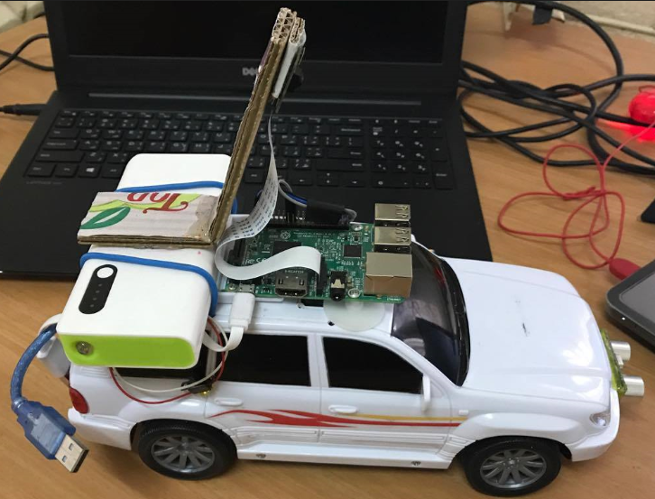
Our project modules
Input Module
Processing Module
Control Module

Slide 6

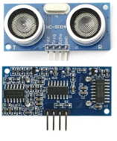
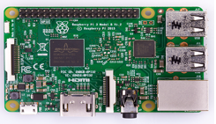
Input Module
This module consists of a Raspberry Pi 3 board (model B+), attached with a pi camera module and an HC-SR04 ultrasonic sensor.

Slide 7
Processing Module
This module - computer - is responsible for:
Receiving data from Raspberry Pi neural network creation, training, and prediction(steering).
Object detection -stop sign and traffic light-distance measurement.
Sending instructions to the Arduino.

Slide 8
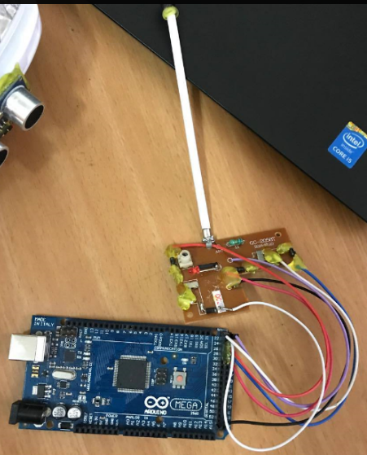
Control Module
An on/off type remote controller controlled by Arduino.

Slide 9
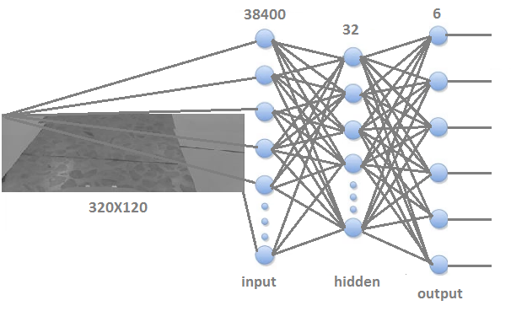
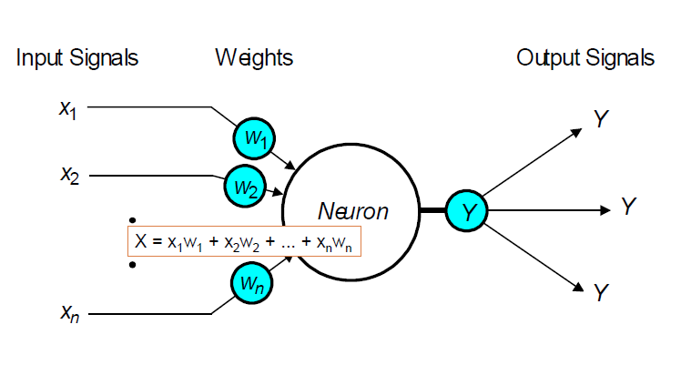
Neural Network

Slide 10
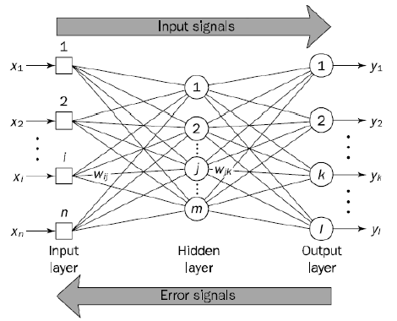
Back-Propagation

Slide 11
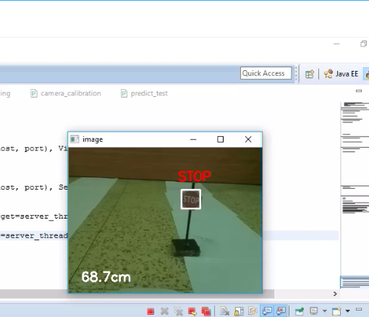
Object detection

Slide 12
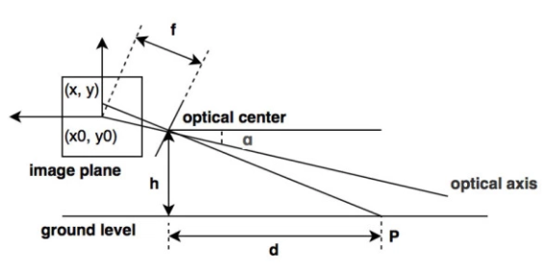
Monocular vision

Slide 13
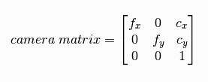
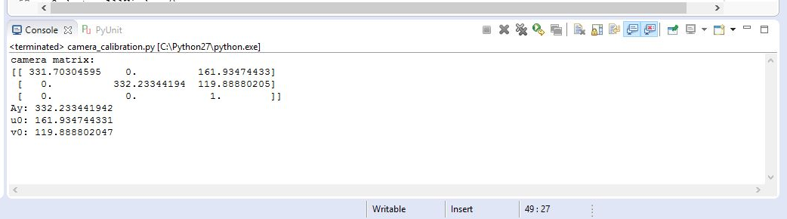
camera calibration

Slide 14
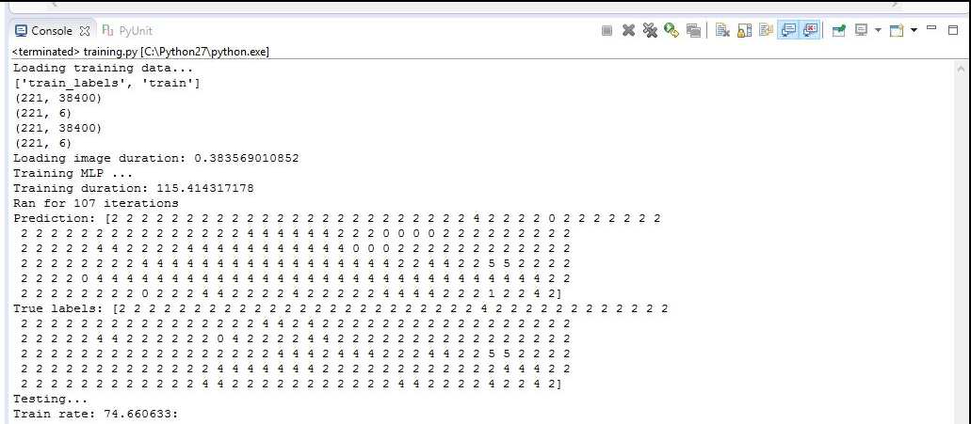
Training and Testing

Slide 15
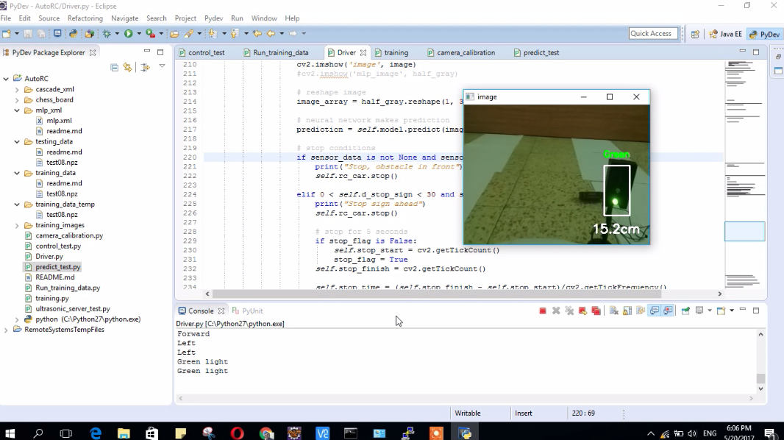
Results

Slide 16
Problems
The low quality build of the car
The remote range was not good and the signal was choppy.
the rechargeable batteries life was short.
we had to use a power bank and it was heavy.
we needed to slow the motor in order to get a better result out of training.

Slide 17
Conclusions
We learned a lot about :
Neural Networks and its algorithms.
Image processing
Raspberry pi and Arduino

